Slide 1
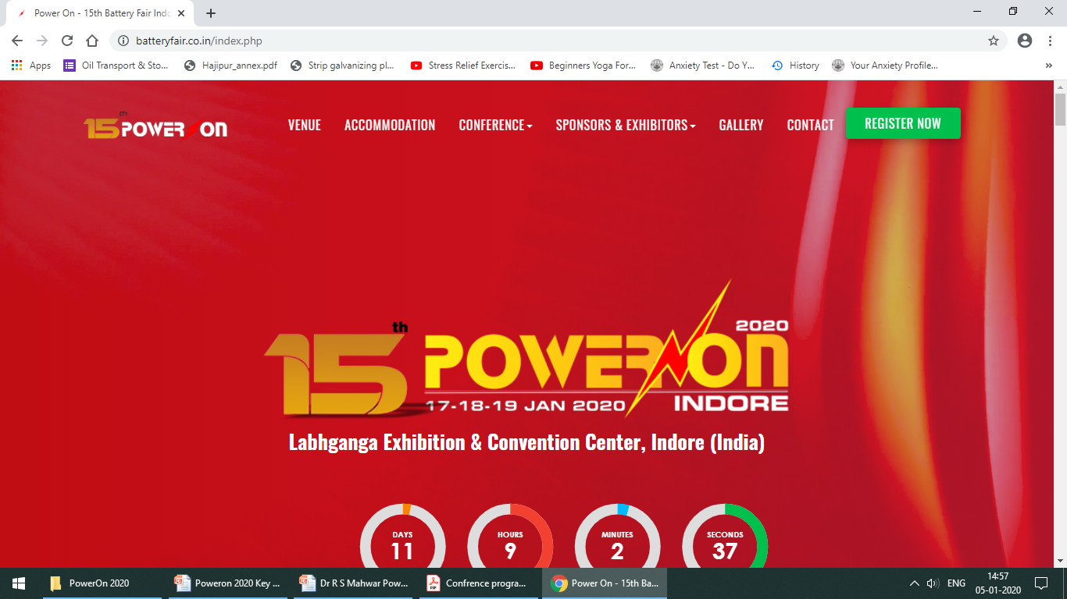
Import of Lead Scrap/Used Lead Acid Batteries in India - Policy and Requirements
By
Dr R S Mahwar, Environmental Adviser & Consultant
Former Director (Addl.), Central Pollution Control Board, Delhi
National Battery Summit: Indore
Technical Advancement of Battery Manufacturing in India (MSME Sector)
Emerging Trends and Avenues of Lithium Batteries in India
JANUARY 16, 2020, INDORE

Slide 2
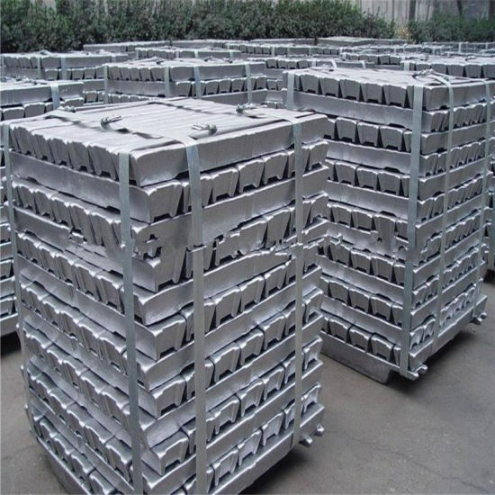
Transboundary Movement (Import/Export) of Lead – Key Drivers
Lead is a naturally occurring material
Lead inventory of the planet is fixed
Lead can not be created or consumed or destroyed (unlike tyres, plastics etc)
(Anthropogenic activities only change its forms in a close loop with some
releases back to the environment)
Lead is not found occurring naturally in all countries

Slide 3

Global Lead Flow Cycle
Lead Reserves
Primary Metallurgy
Primary
Lead
Lead
Other Uses
LAB
Automobiles
Other Uses
ULAB
Recycling
Environment

Slide 4
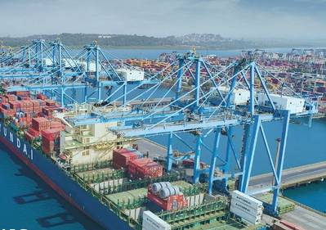
Need of Lead Import in India – Key Drivers
Lead Reserves : Only 2.5% of the World
Total Available : Only 2.2 Million Tonnes
Primary Lead Production Installed Capacity (HZL) : 2,05,000 tonnes per annum
Actual Production : 1,68,000 tonnes (2017-18) (Natural Reserves to last for 15 -20 years at the most)
Secondary Lead Production (Authorised Recyclers) : ....?
(Is it really production or it is just a part of the lead Flow Cycle ? Are we really creating lead ?)
Apparent Consumption* ( Use ? ) : 2,32,000 Tonnes (2016-17)...???
(* Sum of production plus imports minus exports)

Slide 5

Lead Flow Cycle in India (Demand Increasing)
Lead
Reserves (15-20 yrs)
Primary Metallurgy
Primary
Lead
Other Materials Export
Lead Import
Lead
Other Uses
LAB
Lead Export
Automobiles
LAB Export
LAB Import
Other Uses
Automobiles
Export
ULAB
Lead Wastes
Import
Recycling
Other Materials
Import
Uses
Environment

Slide 6
Lead Scrap/ULAB Import Policy for India – Key Questions
Substitution of LAB with Lithium Ion Batteries ?
Sustainability of Importing lead Ingots and their use ?
Sustainability of Importing of Lead Ore/Concentrate and their processing ?
Sustainability of Importing of Lead Wastes and their recycling ?

Slide 7
Sustainability of Importing of Lead Ore/Concentrate and their processing ?
Lead ore & Lead concentrate are raw materials and not wastes
Lead from Lead ore & Lead concentrate is primary metallurgy
Requires Environmental Clearance (EC) under Cat 3(a) of the EIA Notification 2006
Import of Lead from Lead ore & Lead concentrate and its processing:
Larger quantities of lead bearing wastes to remain in India
Lead Scrap/ULAB generated will still need recycling or export
Obtaining of EC and processing by Lead recyclers without expansion
will mean equivalent reduction in the recycling capacity for Lead Scrap/ULAB

Slide 8
Sustainability of Importing of Lead Wastes and their recycling?
Lead Recycling from lead scrap/ULAB is secondary metallurgy
Less burden on landfills compared to Primary metallurgy
Exempted from the requirement of obtaining Environmental Clearance
Wider choice in recycling facility location
Sustainability much better than primary metallurgy
Recycling will become unavoidable after the natural reserves gets exhausted

Slide 9
DGFT Policy (2017) for Lead ULAB/Scrap
CHAPTER 78 : Lead and articles thereof
EXIM Code : 7802 00 10 - Lead waste and scrap
Import permitted without DGFT License
CHAPTER 85 – Electrical Machinery and Equipment and parts thereof
EXIM Code : 85481010 - Battery scrap namely : Lead battery plates covered by ISRI code word ‘Rails’; Battery lugs covered by ISRI code word ‘Rakes
Import requires DGFT License
EXIM Codes : 85481020 - Battery waste namely - Scrap
drained or dry while intact, lead batteries covered by ISRI code word Rains’
Import requires DGFT License
EXIM Code : 8548 10 90 - Other waste and scrap
Import requires DGFT License

Slide 10
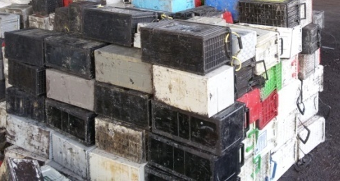
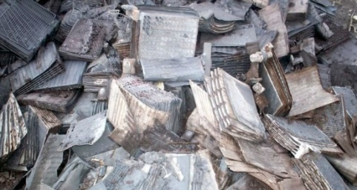
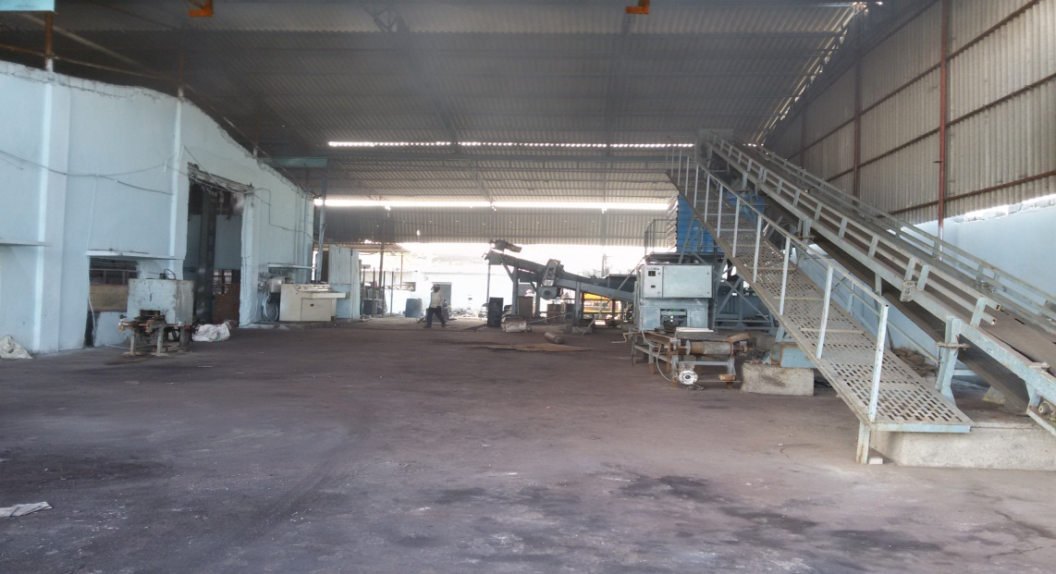
Environmental Legislation/MoEF Policy for Lead Wastes Imports
Waste lead acid batteries* whole or crushed
Basel No - A1160
HW Rules 2016 – Part A
Permitted with Prior Informed Consent
(*Drained Batteries Only)
Lead Scrap - Bulk finished form such as plates
Basel No - B1020
HW Rules 2016 – Part B
Permitted without Prior Informed Consent
Annual Quantity Permitted
33% (1/3rd) of the Recycling Capacity**
ULAB import permitted only to units
having Automatic Battery Breaker
(**125% of the Smelting Capacity)

Slide 11
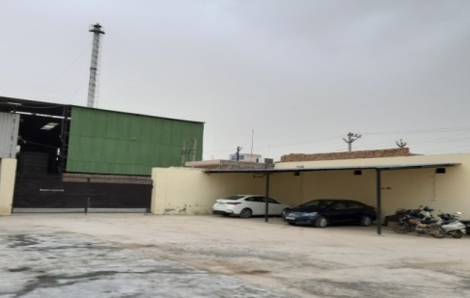
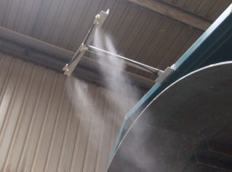
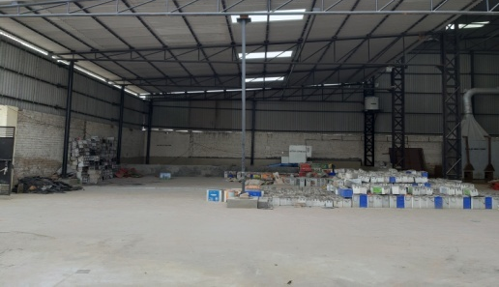
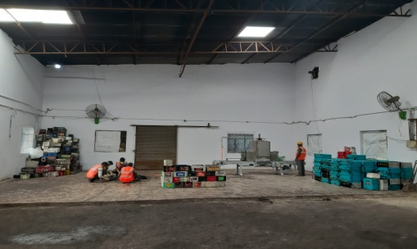
Recycling Facilities Requirements
Lead Waste Receipt & Unloading
Separate Approach Road
Separate covered storage area
Dust Suppression (unloading area)
Battery Breaking
Battery breaking machine/Breaker
Noise control measures
Separate Plastic Washing Area
Impervious flooring
Run off to ETP

Slide 12
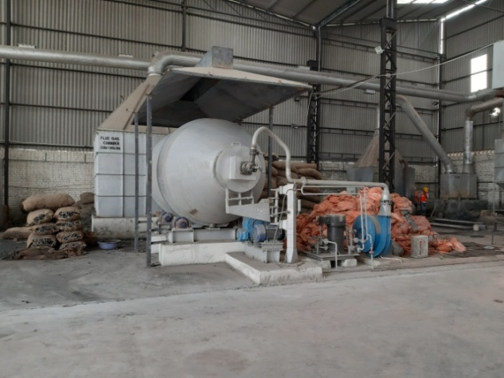
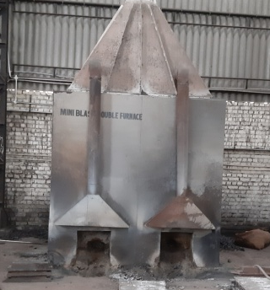
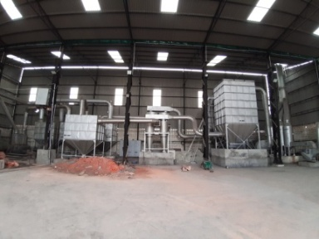
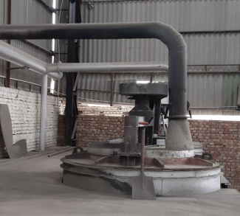
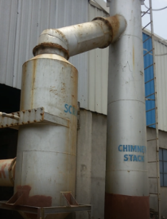
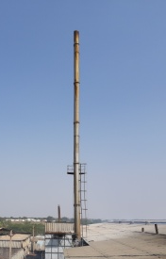
Recycling Facilities Requirements
Rotary or Box Furnace and Refining Pots
Air Pollution Control System (APCS)
Suction hoods covering the charging points
Suction hoods covering the molten lead
tapping points
Expansion/Cooling Chamber
Cyclone Separator
Bag Filter (Pulse jet/mechanical shaker)
Alkaline scrubber (Closed loop with spent liquid going to ETP)
ID fan, Stack
Height – 30 meters (minimum)
Port Hole, platform and access ladder for stack Monitoring
DG Sets- Acoustic enclosure and stack 3 meters above the shed

Slide 13
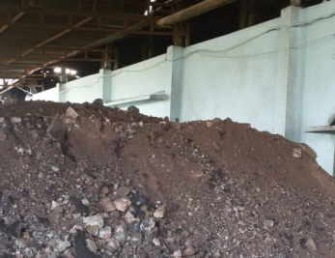
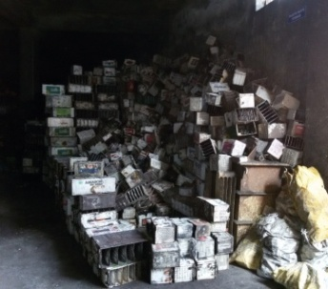
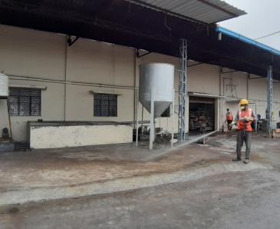
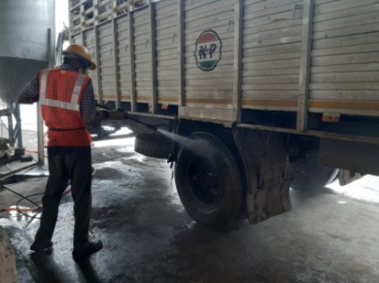
Recycling Facilities Requirements
Storage/Disposal of Hazardous and Other Wastes
Separate and covered storage for HW
TSDF Membership for HW disposal
Separate storage for plastics wastes
Disposal of Plastic wastes to authorised recyclers
Storage/dispatch of Product (Ingots)
Separate and covered packaging/dispatch area
Movement of product dispatch vehicles independent from the raw material handling areas
Tyre Washing Facility
Washings to ETP

Slide 14
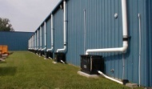
Storm Water Management
Complete segregation of the storm water drains
All lead involving activities to be carried out under covered sheds
Minimum movement from process areas to non process areas
No vehicle movement during rains
Slopes should not permit any water logging

Slide 15
Summary Remarks
Import of Lead Wastes under DGFT Code 7802 00 10 does not require DGFT License
Import of Lead Wastes under DGFT Codes 85481010/20/90 require DGFT License
Import of the ULAB/Lead Scarp is permitted to the authorized recyclers to the
extent of 1/3rd of the recycling capacity subject to obtaining of the import
permission from the MoEF
Import of ULAB is permitted to only those recyclers which have installed automatic
battery breaker unit subject to obtaining of the import permission from the MoEF
Processing of Lead ores/concentrate requires obtaining of Environmental
Clearance under the EIA 2006, regardless of the source of their procurement

Slide 16

Thank You..!
Wishing you all a very productive conference and exhibition!

